Slide 1
Numerical Systems

Slide 2
01101000 01100101 01101100 01101100 01101111 00101100 00100000 01110111 01101111
01110010 01101100 01100100
What do you think this says?

Slide 3
hello, world
Most Recognized Program in the World

Slide 4
Decimal System
Decimal System -> Base 10
Every number can be deconstructed in parts with k * 10^{n}
Regular | 5 | 3 | 6 | 2 | 7
Decimal | 5 * 10⁴ | 3 * 10³ | 6 * 10² | 2 * 10¹ | 7 * 10⁰
50,000 + 3,000 + 600 + 20 +7
53,627

Slide 5
Binary System
Binary System - Base 2
Binary Code | 1 | 0 | 1 | 1
What it represents | 2³ | 2² | 2¹ | 2⁰
The Ns place | 8 | 4 | 2 | 1
1011₂ = 8 + 2 + 1 = 11

Slide 6
Practice Problem
Convert 46₁₀ into binary
Binary | 1 | 0 | 1 | 1 | 1 | 0
Ns Place | 2⁵ = 32 | 2⁴ = 16 | 2³ = 8 | 2² = 4 | 2¹ = 2 | 2⁰ = 1
46
- 32
---------
14
14
- 8
---------
6
6
- 4
---------
2
2
- 2
---------
0
101110₂

Slide 7
Other Numeric Base Systems
Octal -> Base 8
Hexadecimal -> Base 16

Slide 8
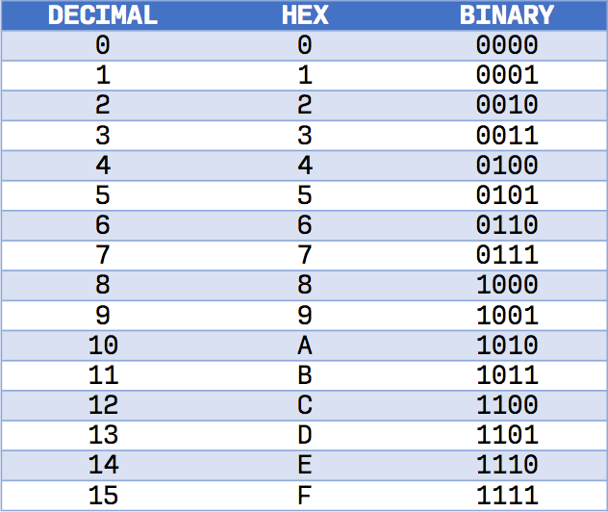
Source: Make Tech Easier

Slide 9
Convert 1984₁₀ into hexadecimal.
Number | 0 | 7 | 12 | 0
Ns Place | 16³ = 4096 | 16² = 256 | 16¹ = 16 | 16⁰ = 1
256
* 7
-------------
1792
1984
- 1792
-------------
212
16
* 12
-------------
212
212
- 212
-------------
0
7( 16²) + 12(16¹) + 0(16⁰) = 1984
0 7 12 0 = 7C0₁₆
Practice Problem #2

